Slide 1
Nuclear Magnetic Resonance Survey vs. 3D Seismic Survey
A Comparison of Two Exploration Technologies
Radiant Exploration, Inc.
Lakewood, Colorado

Slide 2
Sequence of Exploration Events
Oil Lease is acquired in Rooks County Kansas by American Patriot Oil
American Patriot Oil Requests NMR Survey To Be Conducted by Radiant Exploration, Inc.
Radiant Exploration Surveys Section 1 of T 7 S, R 19 W
Radiant Exploration Conducts Secondary Depth Survey to Areas Containing Oil Within the Survey Block
American Patriot Requests That Radiant Exploration Select a Drilling Location
Survey and Data Analysis is Completed by Radiant and Submitted to American Patriot Oil

Slide 3
Sequence of Exploration Events II
American Patriot Oil Purchases Seismic Lines and Interpretation from XYZ Company, and Consults with Blank Geophysical.
American Patriot Oil and Consulting Geophysicists Determine that the NMR Survey Conducted by Radiant Exploration Correlates Exactly with the Seismic Interpretation in Terms of Locating a Subtle Stratigraphic Trap That Contains Oil, and Where to Place the Drilling Location for Best Possible Results.

Slide 4
NMR + Seismic = Reduced Risk
Advantages of Seismic
Outstanding for developing subsurface geology model
Disadvantages and Limitations of Seismic
Limited information regarding the presence of and fluid type in an identified potential hydrocarbon trap
Long Lead times for permitting, data acquisition, data processing and interpretation.
Very Expensive – Cost prohibitive in most cases for small operators

Slide 5
NMR + Seismic = Reduced Risk
Advantages of Nuclear Magnetic Resonance Survey
Technology is deployed remotely, no need for permitting or on surface presence for data gathering
Rapid deployment and turn around times
NMR delineates where oil is located, depth analysis can determine pay zone thickness and up dip/down dip orientation of sedimentary strata.
Some structures may be discovered depending on trapping environment, ie. Oil trapped on one side of a fault

Slide 6
Advantages of Nuclear Magnetic Resonance Survey Continued-
Prospect areas can be evaluated prior to purchase
Ideal First Exploration Tool – Can save money on other exploration expenses by providing targeted guidance for layout of seismic lines, geochemical grids etc.
Very large areas can be covered for Resource Evaluation in unexplored areas
Cost effective for small operators

Slide 7
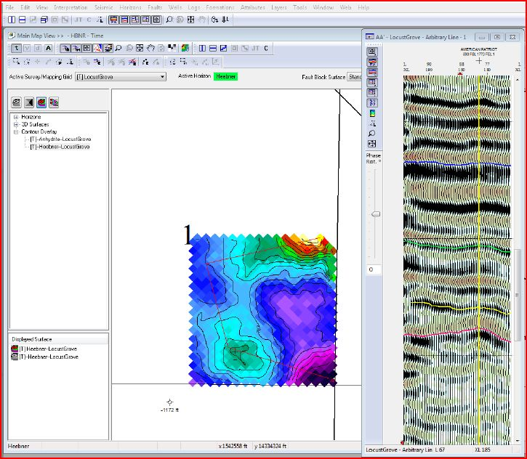
Seismic With Heebner Formation Contour and Cross Section Subtle Stratigraphic High in SW ¼ of SE ¼ of Sec. 1

Slide 8
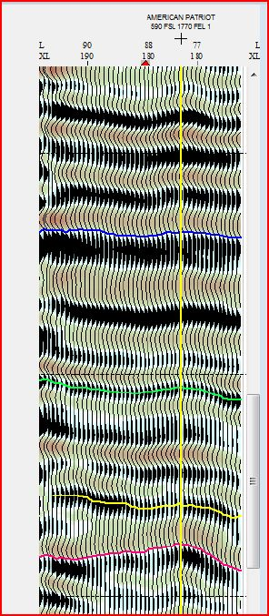
Seismic Cross Section Zoomed Drilling Location-Yellow Vertical Line

Slide 9
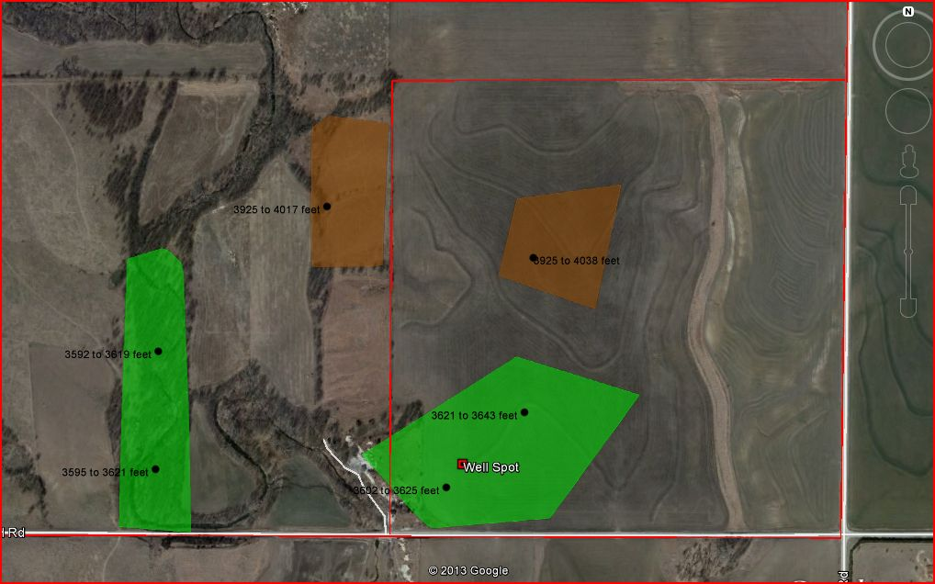
Radiant Exploration NMR Survey Results – Note the location of oil found in the SW ¼ of SE ¼ of Section 1. Pay zone thickness is approximately 22’. Other oil deposits discovered on lease and off lease.

Slide 10
Summary
NMR is an Excellent Pre-Lease, Pre-Exploration Survey Technology
NMR can Save Exploration Program Dollars by Decreasing or Eliminating Tracts from Additional Exploration
NMR Used in Combination with Seismic Data Provides Spatial Location of Oil with Structural Trapping Information - Decreases Dry Hole Risk

