Slide 1
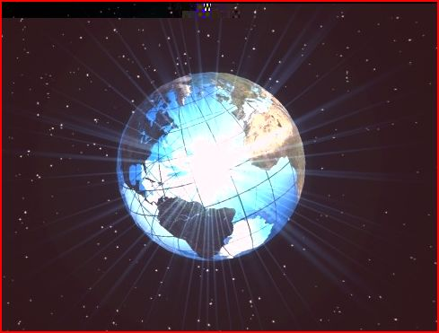
Radiant Exploration, Inc.
NMR Survey For Exploration of
Precious and Base Metals
Industrial Minerals

Slide 2
NMR Remote Sensing Survey Detects the Presence of Any Periodic Table Element
Metals, Au, Ag, Cu, Zn, Pb, etc. can be mapped where detected in linear features such as faults and fractures, or can be mapped as detected in disseminated ore bodies or concentrated ore shoots.
Radiant Exploration cannot determine ore grades, just the presence of the metal of interest, and it’s location within the mineral complex.
NMR is a very powerful Reconnaissance Tool to create a road map for the application of other Geophysical Methods, or the execution of a Core Drilling Program. The Potential for New Discoveries Using This Technology Are Limitless.

Slide 3
Ag-Pb Survey Eastern Washington State
1000 oz/ton vein intercepted by dozer
Ore body detected just below historic workings.

Slide 4
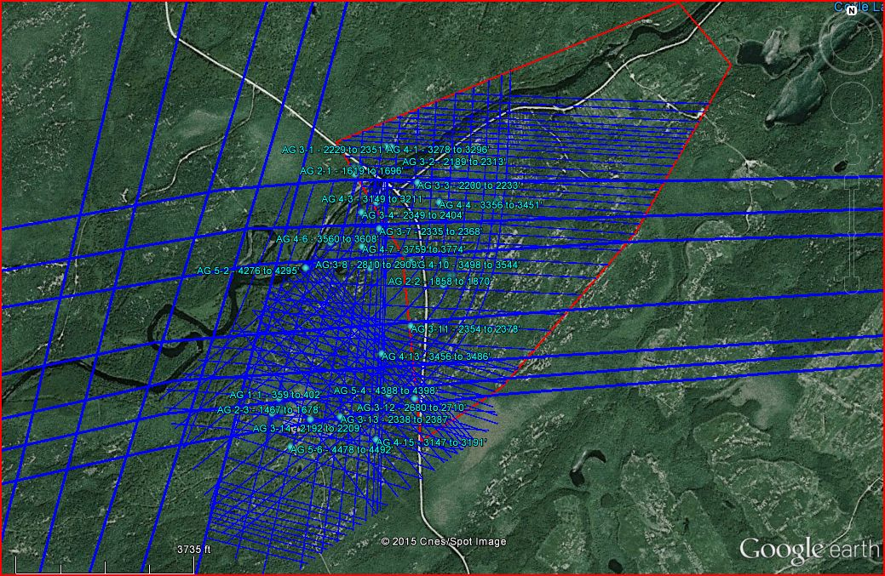
Silver Complex- Greenstone Belt Ontario Canada – Veins and Ore Bodies

Slide 5
Detail of Ore Bodies

Slide 6
Gold Complex- Greenstone Belt Ontario, Canada

Slide 7
Gold Vein System with Ore Bodies

Slide 8
Detailed View of Stacked Ore Bodies with Depths

Slide 9
Dry Alluvium Gold Placer U.S.A.

Slide 10
Radiant Exploration Placer Discovery Process
Contracted by Client to Map Area In Red Box
During High Level Scan Discovered Adjacent Deposit to the West- Reported these additional Discoveries to the Client
Great Example of Value Added Discoveries that can be made using this Technology

Slide 11
Black Points with Depth Range Label Indicate Zones of Highest Indication of Gold Placer

Slide 12
\ NMR Survey-Chile, SA. Pb-Zn-Ag Discovered 3 miles west of Goldcorp Property
Notes:
Toggle back and forth between slides 4-5

Slide 13
Same Photo with Radiant NMR Data Removed Visual Evidence Matches NMR Detected Mineral

Slide 14
Non Mining Application of Precious Metal Discovery Using Radiant Exploration NMR Sunken Buried Galleon off the Coast of Key West

Slide 15
Previous Slide Shows Details Mapped By Radiant Exploration of a Shipwreck 10 miles W-SW of Key West Florida in 40’ of Water, Buried under 4’-10’ of subsea overburden
Blue = Ag, Yellow = Au, Green = Emeralds (Be,Cr)
Iron Cannon and Anchor labeled accordingly
Grey area is where current excavation is taking place.
Evidence of a Shipwreck has been verified, barrel hoops, toredo worm crust, decomposed ships beams etc. have be recovered to date. Excavation continues near Gold targets pending permit approval.

Slide 16
Summary
Remote Sensing Using Proprietary NMR Technology is a Powerful Exploration Reconnaissance Tool.
Additionally, As Shown in this Presentation, Detail Mapping of Vein and Ore Bodies can Potentially Save a Company Millions of Dollars by Defining Targets Early and Reducing Additional Exploration Costs.
NMR Cannot Determine Ore Grade But Can Provide Great Efficiency and Savings in Designing a Core and Surface Sampling Program.

